Slide 1
Auto Pilot And Imitation
Learning

Slide 2
Detecting Unusual Activity:-
Flow of the project:-
1) Using the aerial Violent Individual dataset/ Data Collection:- After capturing a few samples / frames from the dataset using the multiple screen shot module of python, these frames are converted into pixel values. These are displayed on the screen and the user enters the key detecting the type of unusual activity. This is stored as a label for the given converted image and the label along with the pixel intensity values constitute our dataset.

Slide 3
2) Human Recognition From the Image
Feature pyramid networks are used for the detection of humans. An image is inputed to the algorithm and feature pyramid networks use a number of layers for detection.
2 stage detection process
In 1st stage , every spatial coordinate is reduced by 2 depending on the no of layers used.(bottom up process)
In 2nd stage , every spatial coordinate is multiplied by 2 and each layer predicts an outcome based on previous layer and the layer corresponding to bottom up process.

Slide 4
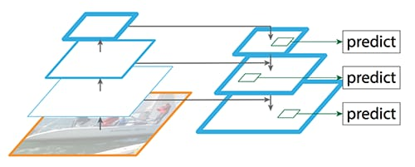

Slide 5
3) Detecting the Pose of the human using ScatterNet Hybrid Deep Learning:-
SHDL networks automatically identify features in the dataset like the angle between the hands let’s say in case of unusual activity detection and then applies an unsupervised learning algorithm i.e. Principal Component Analysis to learn more hierarchical features from the training set. This is done in scatter net front end
These features are used in the hierarchical backend by the regression module for classification purposes.

Slide 6
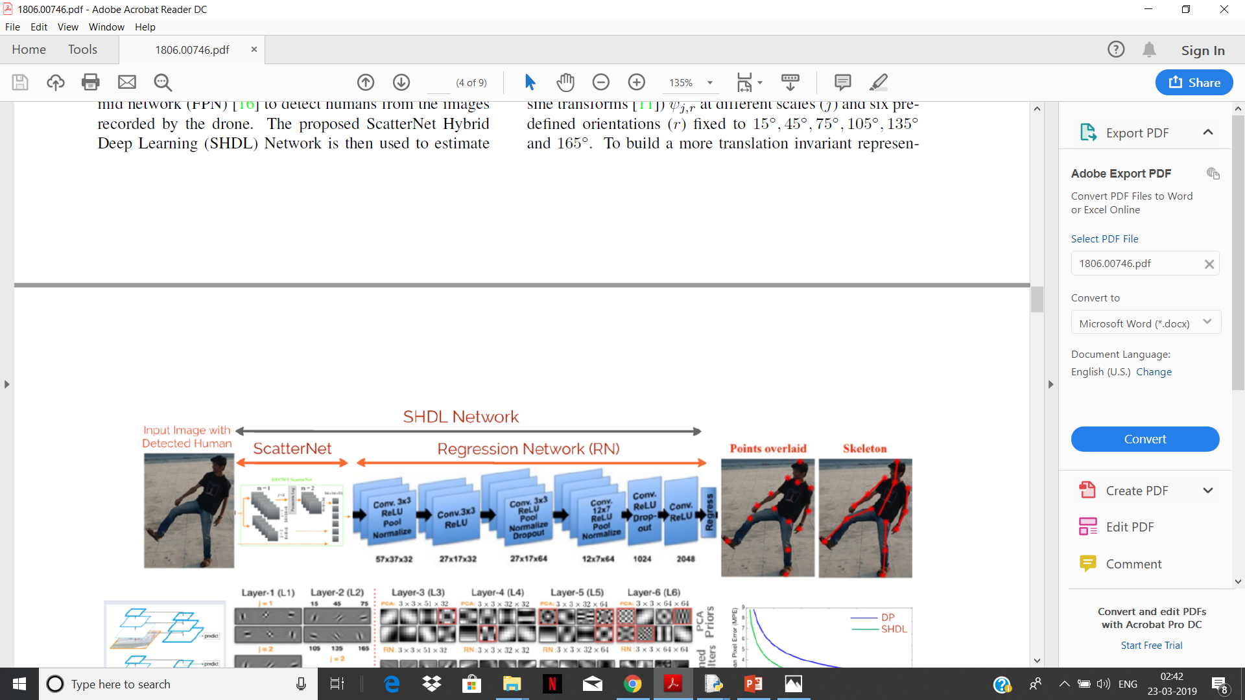

Slide 7
The overlaid points were used to identify whether the human is involved in unusual activity or not through the backend logistic regression classification algorithm.
The code for featured pyramid networks and SHDL network is written with the help of tensor flow and keras libraries in python
The usual train test split procedure was applied for training the dataset i.e. around 75% of data was training data and rest was regard as test data. The model was fit into the training data and accuracy was calculated based on the predictions in the test data.
Classification Accuracy of 80 to 85% was obtained implying the algorithm was doing well on both test and train data

Slide 8
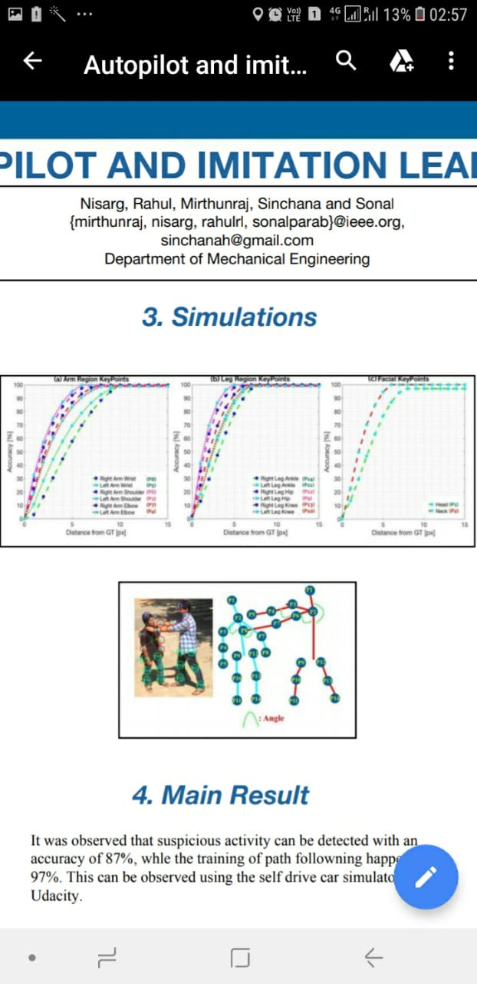
Simulations in Udacity Self Drive Car Software

Slide 9
        Thank You

